Slide 1

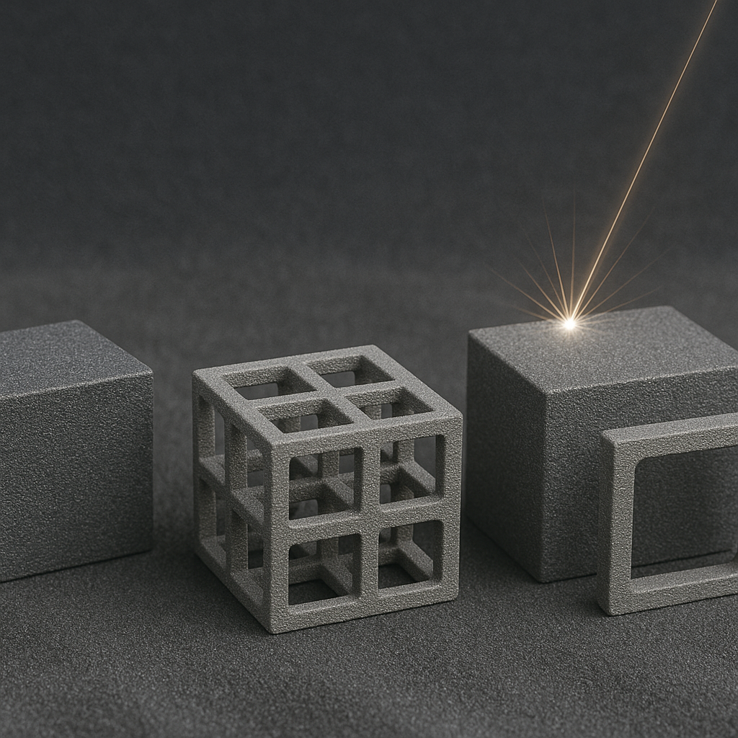
Core-shell structured powders for additive manufacturing
Marina Aghayan

Slide 2
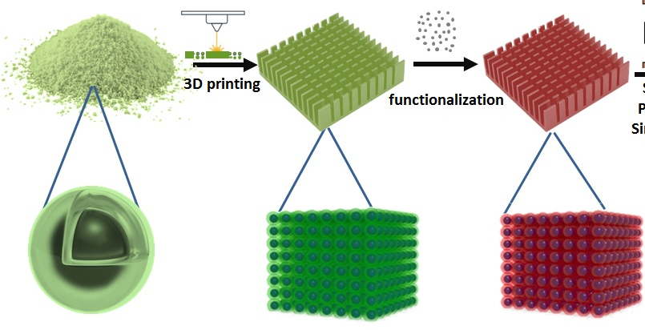
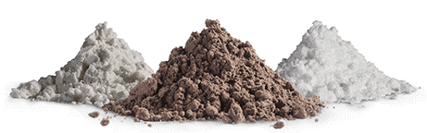
The goal is to prepare feedstock powders for 3D printing technology
synthesis

Slide 3
Milestones (M) & Deliverables (D)
# | Title | WP | Date
CCD | Contract Closure Documentation | 1 | Q4, Q20
FR | Financial Reports | 1 | Q4, Q8, Q12, Q16, Q20
TR | Technical Reports | 1 | Q4, Q8, Q12, Q16, Q20
FinR | Final Report | 1 | Q15, Q20
D1 | Detailed test plan | 2 | Q1
D2 | Detailed design of experiments | 2 | Q1
M1 | Report of requirements and test plan | 2 | Q1
D3 | Optimized Feedstock specification | 3 | Q8
D4 | Report on manufacturing parameters, Q12 | 3 | Q12
D5 | Report on post-processing parameters, Q15 | 3 | Q15
M2 | Selected samples (high resolution photo) with specification available | 3 | Q15
D6 | Report on Material performance | 4 | Q20
M3 | Material Validation | 4 | Q20
D7 | Dissemination and communication plan | 5 | Q1
M4 | Publications (12 research papers) in peer-reviewed international journals | 5 | Q4, Q8, Q12, Q16, Q20
M5 | Contract with academic and industrial partners | 5 | Q12, Q20

Slide 4
TEAM
Member | Position
Marina Aghayan | PM | Management
Tsovinar Galtaghchyan | PhD student | Reactive SLM
Michayel Torosyan | PhD student | Polymer- ceramic composites
Meri Gishyan | MSc student | Feedstock preparation
Hrant Ghazinyan | BSc student | Simulation
Arpine Gilovyan | MSc | 3D printing

Slide 5
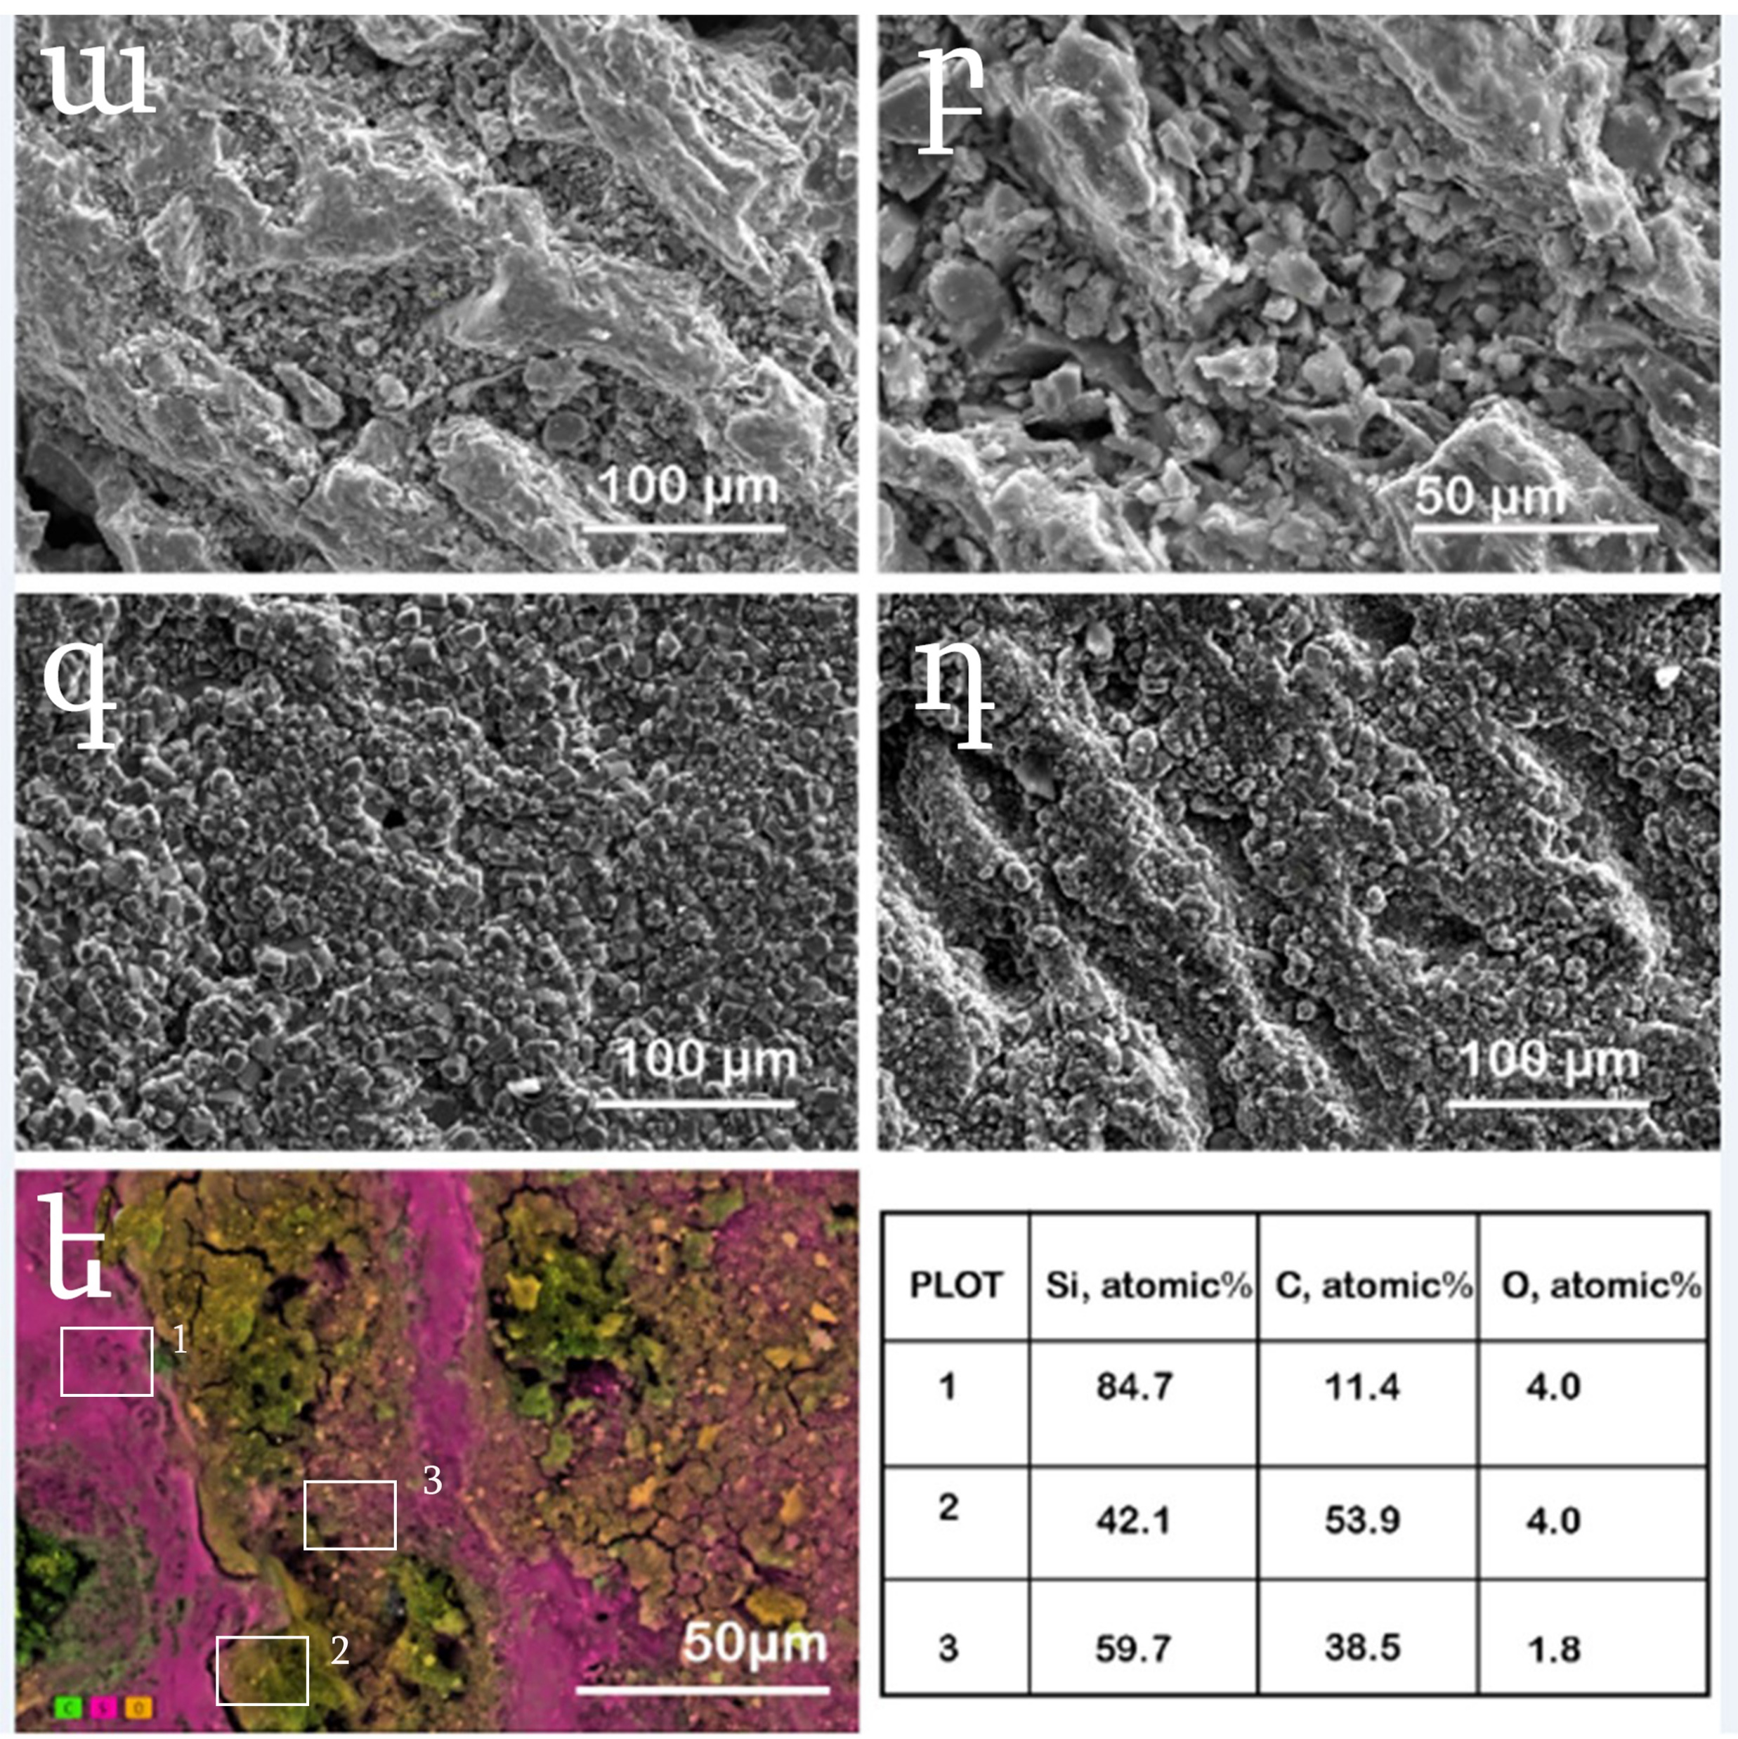
TECHNICAL RESULTS
Reactive SLM of Silicon Carbide

Slide 6
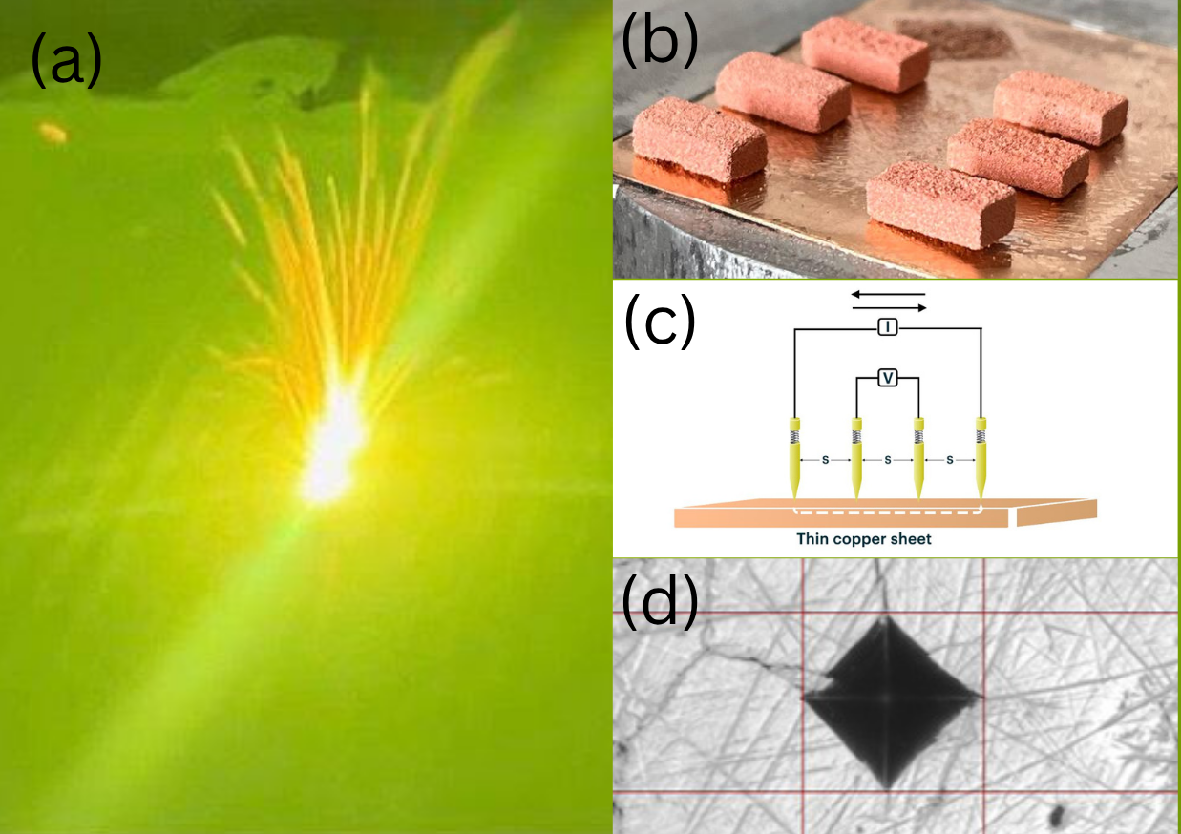
TECHNICAL RESULTS
Low laser power SLM of Copper alloys

Slide 7
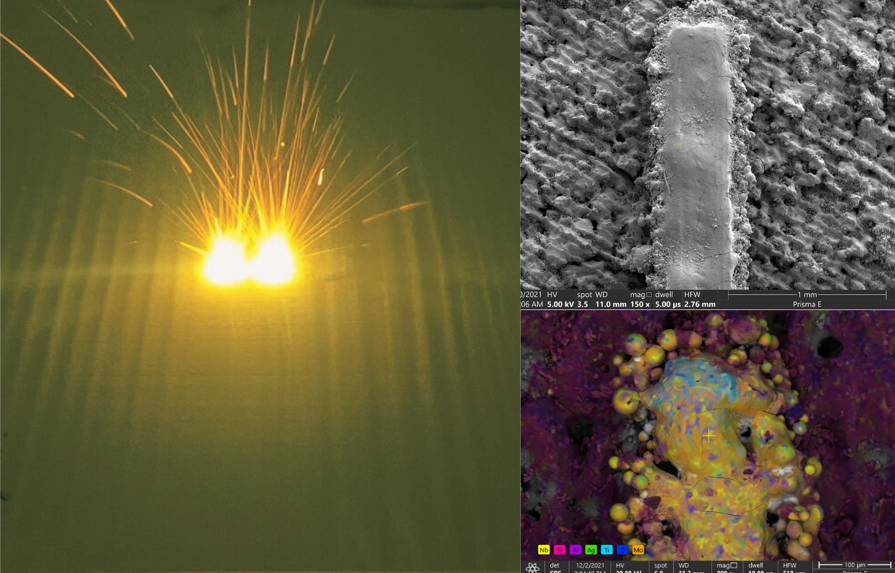
TECHNICAL RESULTS
Selective laser meting of multimaterials

Slide 8
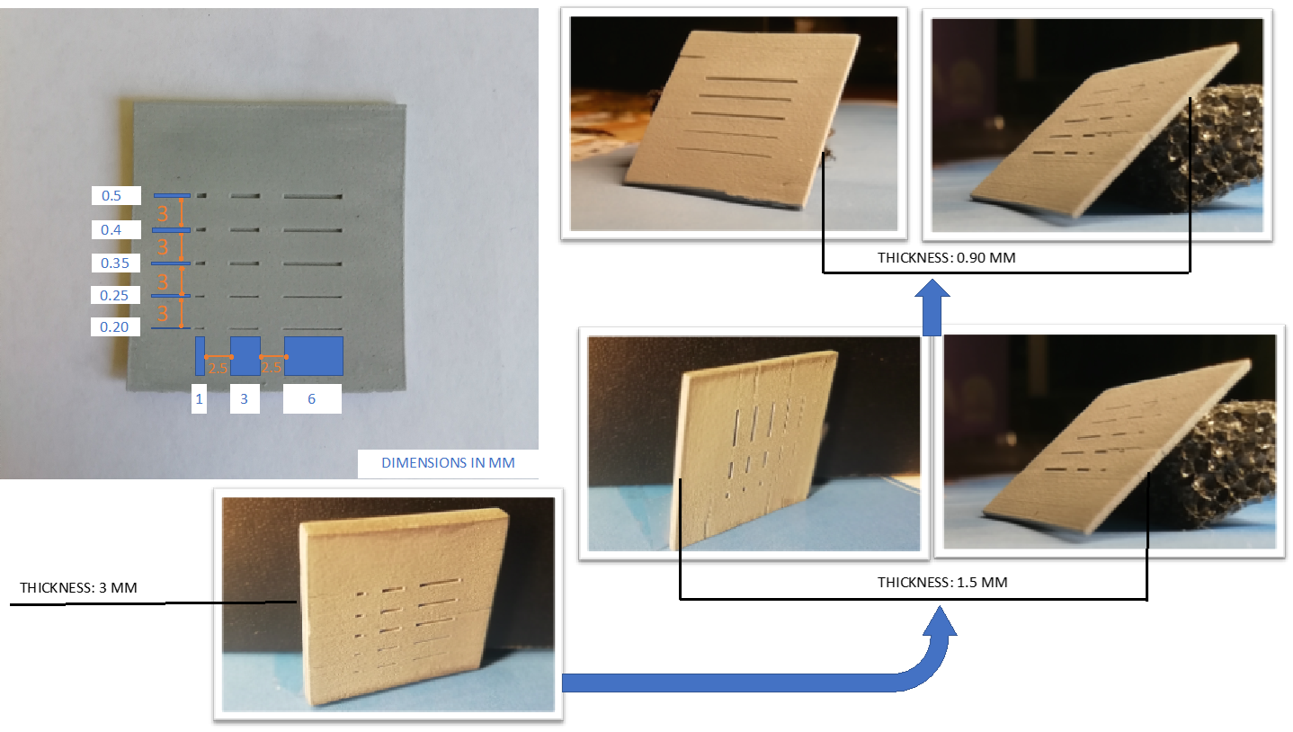
TECHNICAL RESULTS
3D printing of electronic packages

Slide 9
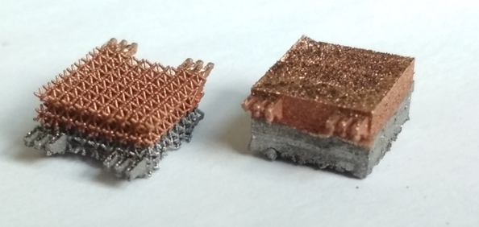
TECHNICAL RESULTS
3D printing of Sandwich structured materials

Slide 10
RESEARCH PAPERS IN 2025
Francois Antounian, Hayk Avagyan, Tsovinar Ghaltaghchyan, Yaroslav Holovenko, Hayk Khachatryan, Marina Aghayan // Designing and additive manufacturing of talus implant for posttraumatic talus avascular necrosis: a case study / Journal of Orthopaedic Surgery and Research, 2024, 1, 1, WOS-ԱԳ (IF) ունեցող պարբերական, 10.1186/s13018-024-04948-w, 1749-799X, 1749-799X. Q1
Marina Aghayan, Tsovinar Ghaltaghchyan // Selective Laser Melting of Molybdenum Alloy on Silicon Carbide Substrate / Materials, 2025, 18(9), 2121, DOI: 10.3390/ma18092121, 19961944, 19961944. Q2
Tsovinar Ghaltaghchyan, Khachik Nazaretyan, Viktorya Rstakyan, Marina Aghayan // Fast carbidization of silicon in additive manufactured Si-C-SiC composite / Results in Materials, 2025, 25, 100653, Scopus, DOI: 10.1016/j.rinma.2024.100653, Q2
Tsovinar Ghaltaghchyan // THERMAL MANAGEMENT SYSTEMS IN SPACE: A REVIEW / Electronic Journal of Natural Sciences of NAS RA of Armenia, 2024, 42 (1), 9-15 NA
Advanced Engineering Materials, “Insights of 3D-Printed Elastic 50A Dielectric Elastomer Layers: Thickness and Temperature Influences on Electro-Mechanical Properties, and Prospects for Artificial Muscle Applications” Currently under second review. Q1

Slide 11
CONFERENCES IN 2025
Marina Aghayan // Additive Manufacturing of Mo-SiC Multimaterial Component / 2025 / Advanced Materials Science, 82-83
Արփինե Գիլովյան, Մարինա Աղայան // Stereolithography of silicon carbide-based composite for electronic packages / 2024
Tsovinar Ghaltaghchyan, Khachik Nazaretyan, Ani Khachikyan, Marina Aghayan // Reactive Selective Laser Melting of Silicon Carbide / 2025
Tsovinar Ghaltaghchyan, Arpine Gilovyan, Marina Aghayan // Stereolithography of Silicon Carbide-based Composite for Electronic Packages / 2024
Marina Aghayan // Additive manufacturing of silicon carbide / 2025 / 3D Printing and Additive Manufacturing, 00 6. Marina Aghayan // Optics and 3D printing / 2024 / OPTICS & ITS APPLICATIONS, 21-22

Slide 12
FINANCIAL

Slide 13

PLANS IN 2026
Organize an international conference
Apply for international grant
2 more PhD students to defence
Open new group

Slide 14
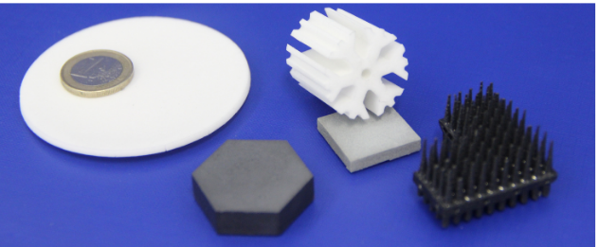
Շնորհակալություն

